Slide 1
🎭 StageAgent
# Personalized Theater Recommendation & Planning Agent
MATH 690 - Graduate Seminar : Agentic AI Project
Students: Ayşegül Yavuz & Makbule Özge Özler
Instructor: Dr. Erdem Özcan
Due Date: December 2025

Slide 2
📋 Agenda
Problem Statement
Solution Overview
Technical Architecture
Prompting Techniques Used
System Components
Demo Scenario
Project Management
Risk Management
Evaluation Metrics
Learning Outcomes
Future Work
References
Q&A

Slide 3
🎯 Problem Statement
Current Challenges
Theater enthusiasts face multiple pain points:
📅 Hard to track which plays are showing when
🗺️ Difficult to filter by location/distance
⭐ No personalized recommendations based on past preferences
🎥 Missing context (actor interviews, reviews)
⏰ Manual calendar coordination
Our Solution
An AI agent that:
Syncs with your calendar
Recommends plays based on your taste
Filters by location and availability
Suggests pre/post-show content (interviews, reviews)

Slide 4
💡 Solution Overview
Core Features
1. Calendar Integration
Automatically finds free time slots
Avoids scheduling conflicts
2. Intelligent Filtering
Location-based (max 30 min travel)
Genre preferences (drama vs. comedy)
Venue preferences (state theater vs. private)
3. Personalized Scoring
Analyzes past ratings
Predicts enjoyment likelihood
4. Content Discovery
Actor interviews (YouTube)
Reviews and articles
Behind-the-scenes content

Slide 5
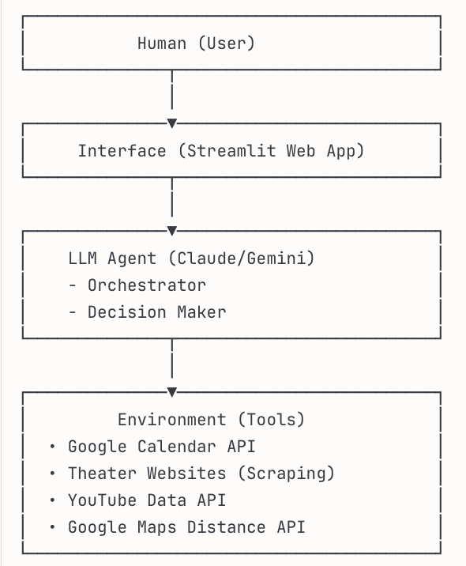
🏗️ Technical Architecture
High-Level Design (From GSU - Agents 2 Lecture Slide 16)

Slide 6
🎨 Prompting Techniques Used
1. Zero-Shot (from Slide 6)
**Use Case:** Simple queries
``` Examples: "What plays are showing today in Istanbul?" ```
2. Few-Shot (from Slide 7)
**Use Case:** Preference prediction
``` Examples:
- "Hamlet" → Liked (Drama, Classic)
- "Comedy Night" → Disliked (Shallow humor)
Predict: Will user like "King Lear"?
```
3. Chain-of-Thought (from Slide 8)
**Use Case:** Multi-step reasoning
``` 1. Analyze user's calendar 2. Find available time slots 3. Filter plays by location 4. Score based on past preferences 5. Rank and recommend```

Slide 7
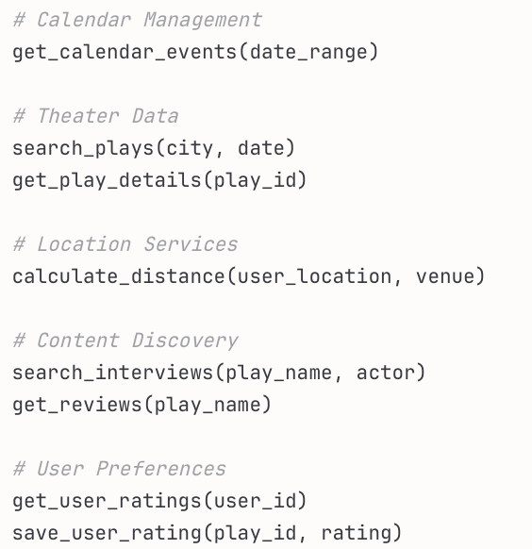
🔧 System Components
Tool Calling (Slide 12)
Possible Available Tools:

Slide 8
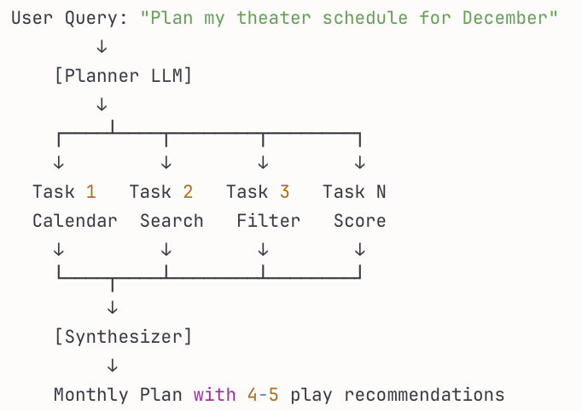
🔧 System Components
🧠 Agentic Architecture Pattern
Planner Pattern (Slide 23)
**Why Planner?
- Complex task requiring multiple steps
- Tasks can be executed in sequence
- Plan needs to be tracked across iterations

Slide 9
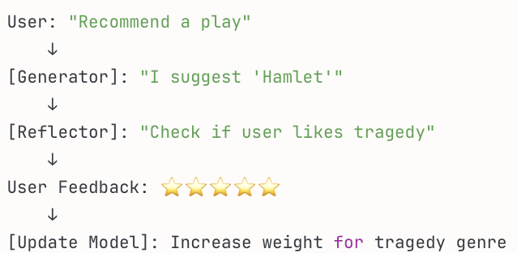
🔧 System Components
🔄 Reflection Loop (Slide 21)
Continuous Improvement
**Benefits:
- Learns from user feedback
- Improves over time
- Self-correcting system

Slide 10
🔧 System Components
🛠️ Technical Stack
i) Backend
- Language: Python 3.11+
- LLM Integration: LiteLLM (multi-provider)
- Models: Claude 3.5 Haiku,Gemini 2.0 Flash
- APIs: - Google Calendar API - YouTube Data API v3 - Google Maps Distance Matrix API
ii) Frontend
- Framework: Streamlit
- Deployment: Streamlit Cloud
iii) Data Storage
- User Preferences: SQLite
- Cache: Redis (for API responses)

Slide 11
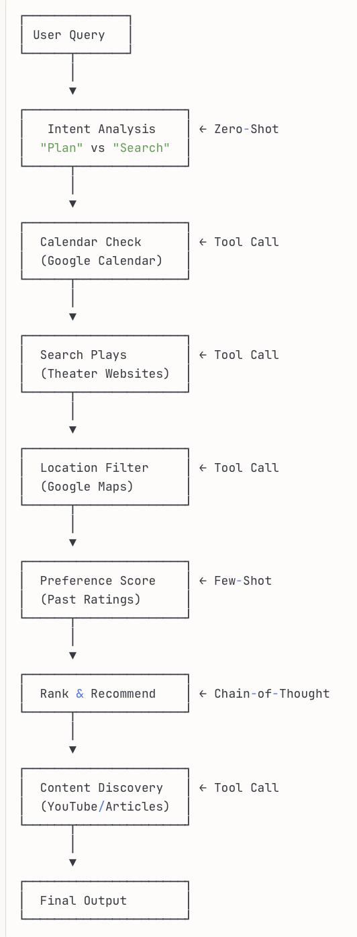
🔧 System Components
📊 System Flow Diagram

Slide 12
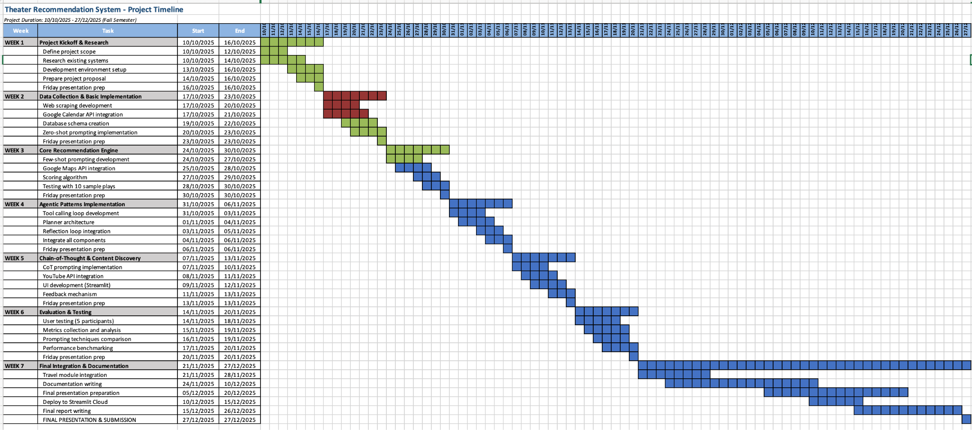
Project Management

Slide 13
Risk Management
1.Technical Risks
(Risk) | (Impact) | (Probability)
API Rate Limits (Google Calendar, Maps) | High | Medium
LLM Hallucinations (Incorrect recommendations) | Medium | Medium
Model Cost Overrun (Claude API expensive) | Medium | Low
4. User Experience Risks
Poor Recommendation Quality (New users with no history) | Medium | High
Privacy Concerns (Calendar access) | High | Medium
Slow Response Time (>10 sec) | Medium | Medium
5. Project Timeline Risks
Week 3-4 Delays (API integration complex) | High | Medium
Final Week Crunch (Integration issues) | Medium | Medium
2. Data Quality Risks
Outdated Play Information | High | High
Incomplete Theater Database | Medium | Medium
Web Scraping Failures (Site structure changes) | Medium | Medium
6. Budget & Cost Risks
API Costs Exceed Budget | Medium | Low
Unexpected API Charges | Low | Low
3. Integration Risks
Calendar API Downtime | Medium | Low
Maps API Changes/Costs | Medium | Medium
YouTube API Quota Exceeded | Low | Low
Notes:
🎯 CONTINGENCY PLANS
If critical failure occurs:
Week 3 API Integration Fails → Use mock data, demo locally
Web Scraping Blocked → Manual data entry for demo (8-10 plays)
Budget Exceeded → Switch to all-free alternatives (OSRM, mock calendar)
LLM Hallucinations → Add human-in-the-loop validation step

Slide 14
🔢 Evaluation Metrics
Accuracy
- Recommendation Hit Rate: (% of recommended plays actually attended )
-Target: (i.e. 70% and above )
User Satisfaction
- Average Rating: (User feedback on recommendations)
- Target: (i.e. 4.2/5.0)
System Performance
- Response Time: (Time to generate plan)
- Target: (i.e. < 10 seconds)
Coverage
- Play Database: Number of plays tracked
- Target: (i.e. 50 plus active plays)

Slide 15
(Expected) Learning Outcomes
1. Agentic AI Patterns
- Planner architecture
- Tool calling integration
- Reflection loops
2. Prompting Techniques
- Zero-shot for quick queries
- Few-shot for preference learning
- Chain-of-thought for complex reasoning
3. Real-World Integration
- API integration (Google Calendar, Maps)
- Web scraping (theater sites)
- Data persistence (user preferences)

Slide 16
🚀 Future Work
Phase 1 (Current Project)
- ✅ Single city (Istanbul)
- ✅ Manual calendar sync
- ✅ Basic preferences
Phase 2
- 🔄 Multi-city support
- 🔄 International festivals
- 🔄 Travel cost estimation
- 🔄 Hotel/flight booking
Phase 3 (Advanced Features)
- 🎯 Group recommendations (friends)
- 🎟️ Automatic ticket purchasing
- 📱 Mobile app (React Native)
- 🌍 Multi-language support

Slide 17
References
Course Materials:
- Lecture Slides: "Prompting LLMs" (Week 3)
- Lecture Slides: "Architecture"(Week 4)
Technical Resources:
- Anthropic Claude Documentation
- LiteLLM Documentation - Google Calendar API v3
- YouTube Data API v3
Inspiration:
- Dr.Erdem Özcan

Slide 18
🙏 Thank You!

Slide 19
Contact
Ayşegül Yavuz
Email: mailtoayz@gmail.com GitHub: https://github.com/ayz-90
Makbule Özge Özler
Email: mak.ozgeozler@gmail.com GitHub: github.com/ozgeozler93

Slide 20
🔗 Demo
Will be Available At [theater-planner-demo.streamlit.app]

Slide 21
💬 Q&A
Possible Common Questions:
Q1: How do you handle multiple users?
A1: Each user has isolated preference profile in database
Q2: What if play info is incorrect?
A2: Reflection loop allows users to report errors, system self-corrects
Q3: Privacy concerns with calendar access?
A3: OAuth2, read-only access, user can revoke anytime
Q4: Cost of API calls?
A4: Cached responses, batched requests, ~$5/month for 100 users

